Slide 1

Dimensional and Relational Design
Understanding the key differences
Louis Davidson

Slide 2















Thank You To Our Sponsors
For Making SQL Saturday Possible!
SQL Saturday Atlanta 2026 • AI & BI
2
Notes:
[Sources] - Conference title, event date, and location are based on the official SQL Saturday Atlanta 2026 event page: https://sqlsaturday.com/2026-03-21-sqlsaturday1127/ - Color palette is derived from the user-provided logo image in this conversation.

Slide 3
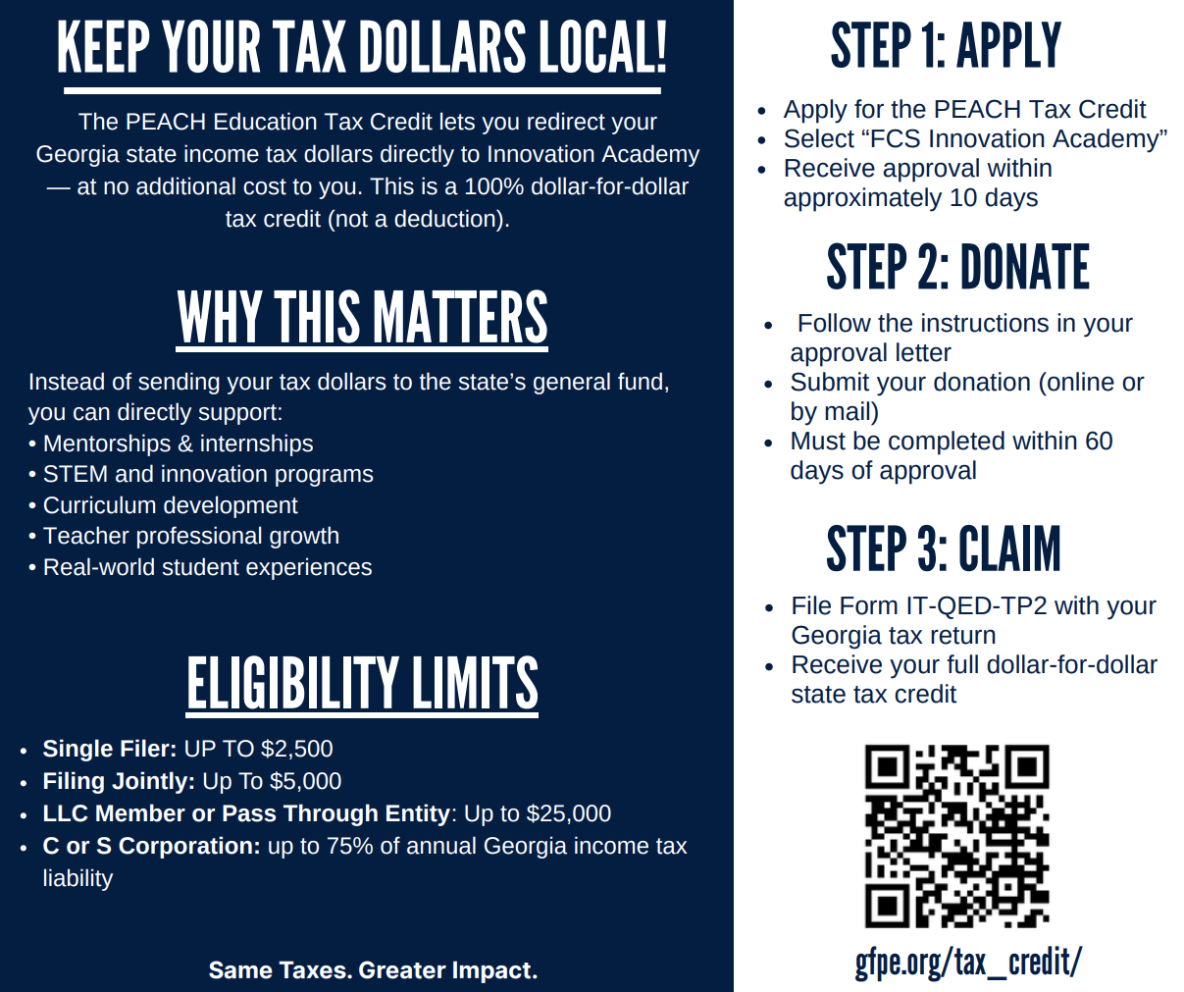

A Very Special Thank You To Our Community Partner
Innovation Academy!
Please Support Via Tax Credit Eligible Donation That Goes DIRECTLY To Innovation Academy
SQL Saturday Atlanta 2026 • AI & BI
2
Notes:
[Sources] - Conference title, event date, and location are based on the official SQL Saturday Atlanta 2026 event page: https://sqlsaturday.com/2026-03-21-sqlsaturday1127/ - Color palette is derived from the user-provided logo image in this conversation.

Slide 4
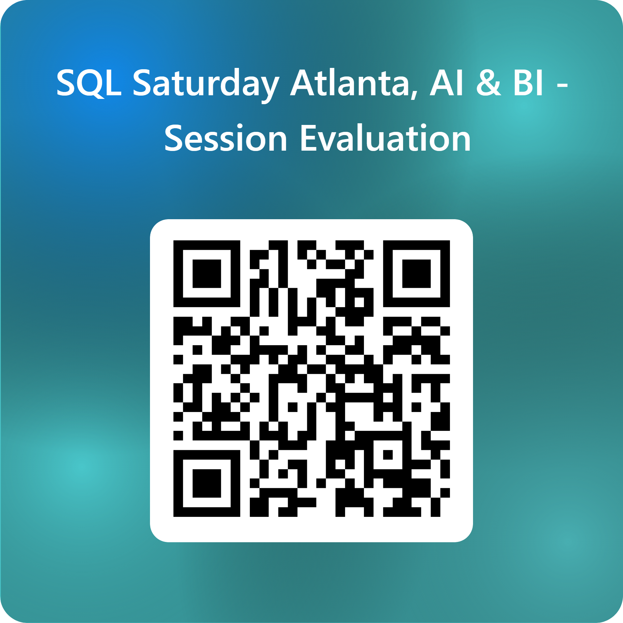
Session Evaluations
SQL Saturday Atlanta 2026 • AI & BI
2
Notes:
[Sources] - Conference title, event date, and location are based on the official SQL Saturday Atlanta 2026 event page: https://sqlsaturday.com/2026-03-21-sqlsaturday1127/ - Color palette is derived from the user-provided logo image in this conversation.

Slide 5
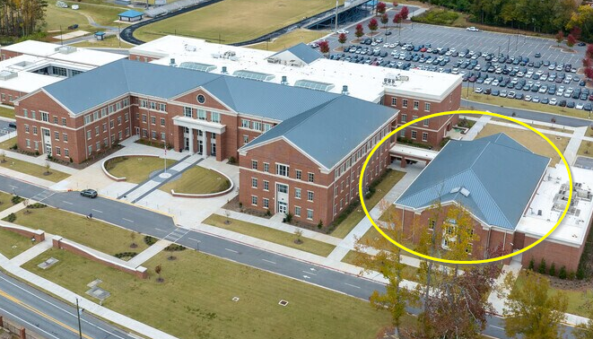
SQL Saturday Atlanta Closing Ceremony
5PM In The Auditorium
Must Be Present To Win Raffle Prizes
SQL Saturday Atlanta 2026 • AI & BI
2
Notes:
[Sources] - Conference title, event date, and location are based on the official SQL Saturday Atlanta 2026 event page: https://sqlsaturday.com/2026-03-21-sqlsaturday1127/ - Color palette is derived from the user-provided logo image in this conversation.

Slide 6
Bit of a warning…
This presentation is interactive
If you don’t interact, I will start daydreaming about going back home to work and I don’t want to think about that yet

Slide 7

And now… on with the show!

Slide 8
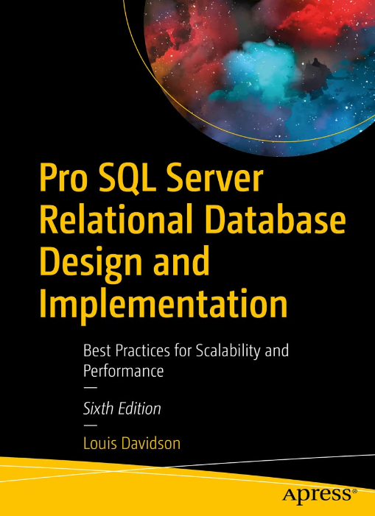
Who Am I?
Database programmer/architect > 30 years
Former Microsoft MVP (19 Times)
Written 6 books on database design
They were technically all versions of the same book.
They at least had slightly different titles each time
Seventh Edition? Who knows?
Super Brief Contact Info: DRSQL
Twitter
Website/blog (.org | .link)
Email (@hotmail.com)
LinkedIn (actually that handle is LouisDavidson, but you can search for drsql)

Slide 9

My background

Slide 11




My non-tech hobby
Instagram: @figmentsintime
xTwitter: @dollywoodp
xTwitter: @disneypicaday

Slide 12

My professional background
Over 30 years as a little bit of a:
DBA
Transact SQL Programmer
Data Architect
ETL Developer
Writer/blogger/speaker/learner about these topics
Written several books on Relational Database Design (Last time I will mention this...most likely)
Went to a few of the Kimball Group’s Classes

Slide 13

Why do we build databases to start with?
Help AI help us
Determine trends
Record Some Activity
Act on the activity
Immediately report that this action has occurred
Indirectly trigger actions to occur
Be prepared for audits
Notes:
Why do we build databases?
To allow high throughput of data being input.
Of course… but what good is data if it is stored poorly?
To DO things with the data
#1 to capture that an action has or has not occurred
Short term reports
Long term reports
Process returns
Prevent future issues
Marketing (which does sound better than advertising!)
#1 is generally the one that is truly treated as important as immediate questions are asked
Customer ordered product, didn’t get it
Why did’t customer get this email
Customer said if we send them another freaking email…

Slide 14

Similarities Between Dimensional and Relational
Both are data stored to be used
Often using the same data storage technologies
Both typically focus on table structures
Rows, Columns with Scalar Values
Some of the core skills involved
Relational Database Engines (Or something that behaves similarly)
SQL
Most important similarity
Organizations rely on data from relational and business intelligence systems to make important decisions
Data Quality is ESSENTIAL
AI??
These similarities are often the start of issues…

Slide 15
Difference: Purpose
Relational – Core Business Functions
Stores state information that reflects ongoing activities (such as sales and customer data).
Data storage usually necessitates ACID compliance (Atomicity, Consistency, Isolation, Durability)
Commonly associated with transactional systems (OLTP)
Usually accessed through a predetermined interface
Dimensional – Analysis through time
Converting transactional data into actionable insights
Commonly thought of as analytics (OLAP)
Aimed at facilitating significant decision-making processes
Can include a computer interface or allow users to run queries directly using the database as an interface
Notes:
Fix spelling of thought

Slide 16

Difference: The Data Lifecycle
Relational: Live, frequently modified data
Generally, we keep all states/actions/etc that have occurred
With at least the data you need to serve users and keep work going
May even be the legal documentation for actions (which can change retention rules)
Dimensional: Typically a set of copies starting with relational (and other data)
Kimball had a metaphor of a kitchen with 3 areas:
Prep area: no user access, but all the data you need to serve anyone
Chef table: cleaned data, likely formatted. Some users get access, but it is a special, power user access only
Dining Room: where data is served to the guests in the way they need it
Fabric has the Medallion architecture
Biggest thing is you keep copies of ALL the data the user may WANT to access.

Slide 17

Difference: Modeling approach
Relational:
Things that exist
Basically store the memory of a something or some process
Goal is to match the design exactly to the customer’s real world
Can be very complex, if the customer’s needs are complex
Eliminate duplication to enhance integrity
Dimensional
Actions you want to quantify
Goal is to be able to answer the customer’s questions
Tuning your design to their needs is not simple
Allow duplication to enhance usability

Slide 18
Difference: Model Structures
Relational
Based on Normalized Structures
Eliminates redundancies at all levels
Optimized for adding, modifying, and deleting data consistently
Tables represent individual concepts (nouns) and relationships between them
Dimensional Modeling
Star Schema
Fact table: Basically a single answer to one or more core questions about an action (grain)
Measures: Numeric details you can aggregate on
Dimensions: Factors you can group the answers on
Dimension Tables: Tables for more complex dimensions
Snowflake Schema
Star Schema with some normalization in the dimensions

Slide 19

Warning:
The next examples are very simplistic and for a brief description only. Your actual designs will be a lot more complex
(Or your users will be very frustrated with you!)

Slide 20
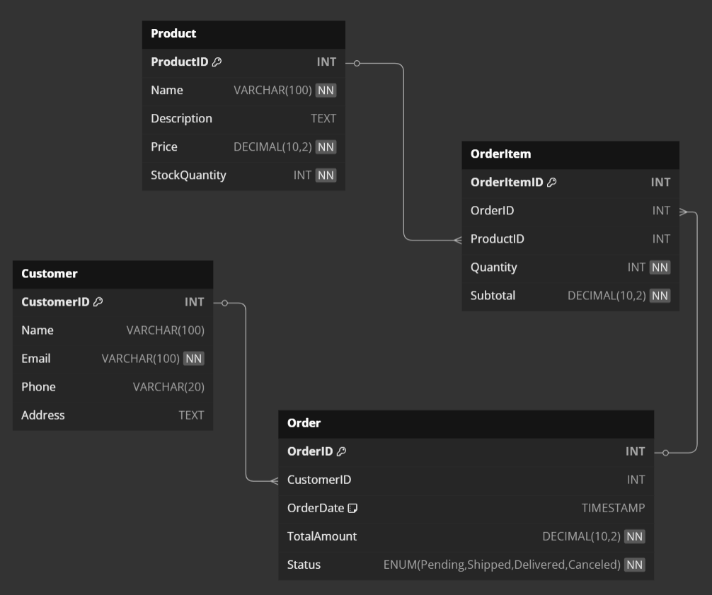
Model Example Relational

Slide 21
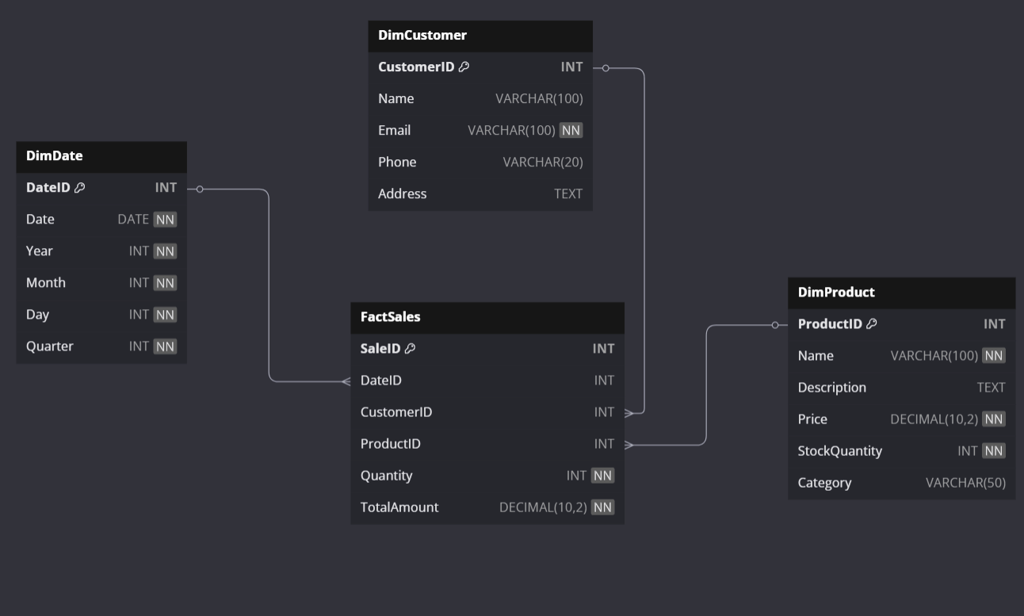
Model Example Dimensional

Slide 22
Difference: “Usually”
"Usually"
Does not apply: Relational Designs
Does apply: Business Intelligence Designs
Example “Our orders usually only have one item per order”
Relational:
If it CAN occur, it MUST be in the model
We never model separate structures for the “exceptions”
Dimensional:
Make sure questions can be answered correctly
Different questions using the same data MAY result in new structures

Slide 23
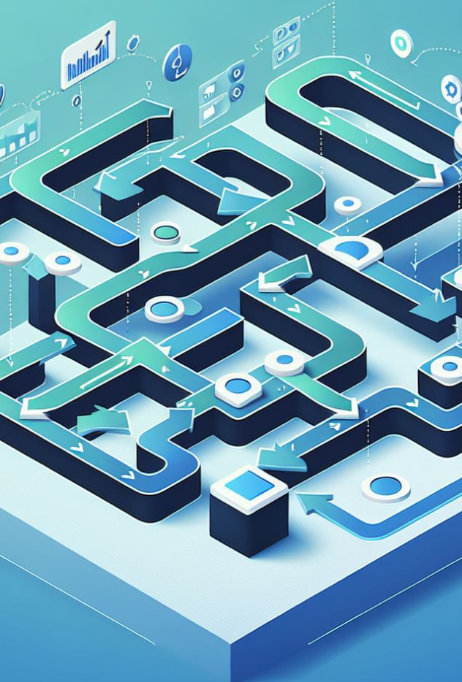
Difference: Normalization
I don’t like the notion that Dimensional Models are "DENORMALIZED"
Both typically do First (and arguably Second) Normal Form
Each table represents one concept
Each row represents one unique example of that concept
Each column represents one aspect about what the row represents
From there, they diverge:
Relational: All about breaking things down and avoiding duplication
Dimensional: Answering the questions easily and quickly is what matters. Controlled duplication is acceptable, even desirable.

Slide 24

My Biggest Mistake

Slide 25
In conclusion
Relational Database Model State
Dimensional Databases Model Activities
Data Warehouses May Include A Bit of Both
If something MAY occur, it:
Must be modeled in your Relational Databases
Only needs to be understood in your output for Business Intelligence Databases

Slide 26

That’s it, time to wake up..

Slide 27

Questions? Contact info..
Louis Davidson – louis@drsql.org
Website – http://drsql.link
Get slides here: https://drsql.link/presentations
Blog – https://drsql.link
LinkedIn – https://linkedin.com/in/louisdavidson
Notes:
[twitter] Slides will be on drsql.org in the presentations area for this and the keynote as soon as I can get them out there. @rmtechtrifecta [/twitter]

Slide 28

Thank you!
https://drsql.link/presentations

